Slide 1
Unit 4.4: Water Resources
What causes water shortages?
How can we solve this problem?

Slide 2
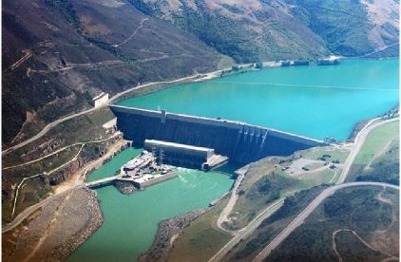
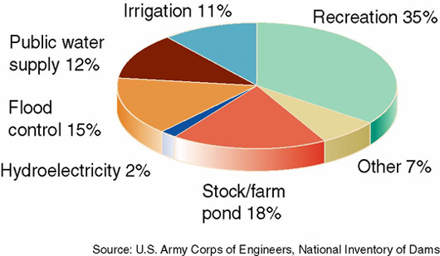
Building Dams
Disadvantages:
Advantages:
Cheap, constant electricity
Reduces downstream flooding
Storing water year-round for irrigation and cities.
Reservoirs can provide recreational activities
Displaces people
Disrupts aquatic ecosystems (i.e. fish migrations/ runoff)
Flooding can destroy surrounding forests and croplands
Large loss of water through evaporation
Reservoirs behind dams collect increased levels of silt and slow water flow.

Slide 3
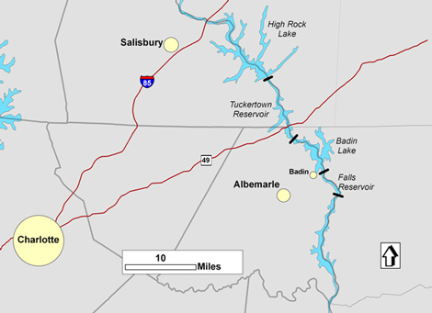
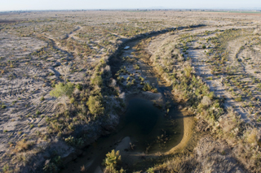
Building Dams
Multiple dams control the timing and flow of water downstream
Can reduce the downstream flow to a trickle & prevent it from reaching the ocean as part of the hydrologic cycle
Colorado River runs dry seasonally
Ganges & Indus in SE Asia runs dry seasonally
Bigger issue on west coast than east.

Slide 4
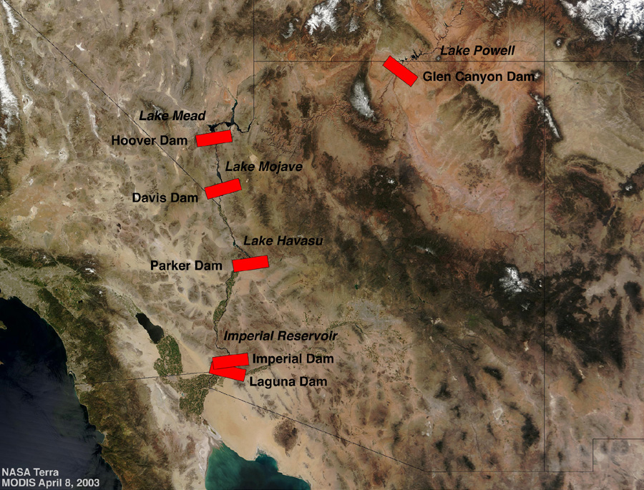
Colorado River Basin
Colorado River has so many dams
it doesn’t reach the ocean
Used for hydroelectricity, irrigation (80%) and recreation (whitewater rafting, camping, fishing) for over 7 states.
Lake Mead at Hoover Dam, October, 2007. According to Scripps researchers, Lake Mead could be dry by 2021 if climate changes as expected and future water usage is not curtailed. Photo courtesy of Dr. Ken Dewey, Applied Climate Sciences Group, University of Nebraska, Lincoln

Slide 5
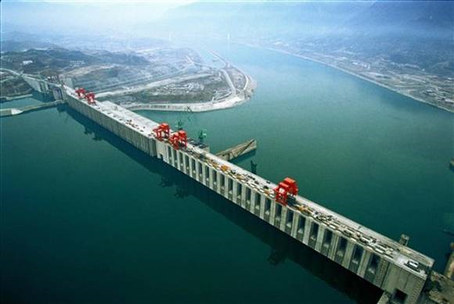
China’s Three Gorges Dam
Good News:
Provide electricity of 18 coal burning plants and reduce China’s dependence on coal
Improves air quality
Larger ships can enter interior
less in transportation costs
Prevents floods that have killed over 500,000 people
video
Once completed (2013), it will be the world’s largest dam and reservoir.
Bad News:
1.9 M people being relocated
Changes ecosystem
Build over a seismic fault
Flooding potential
High costs

Slide 6
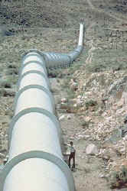
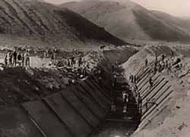
Transferring Water
Moving water from water-rich areas to water-poor through tunnels, aqueducts, and underground pipe can be helpful and harmful.
Movement of water from Northern California to arid regions of Southern California

Slide 7
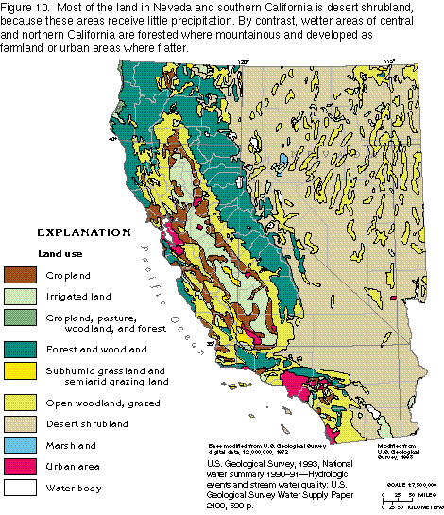
Most of the land in Nevada and southern California is desert shrubland, because these areas receive little precipitation. By contrast, wetter areas of central and northern California are forested where mountainous and developed as farmland and urban areas where flatter

Slide 8
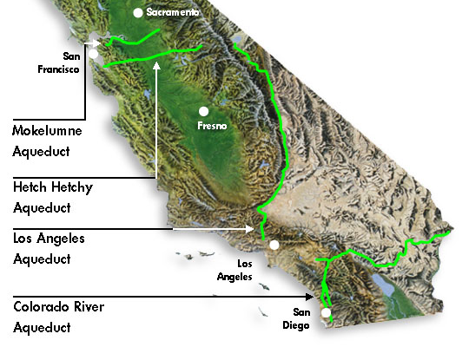
LA Aqueduct is

Slide 9
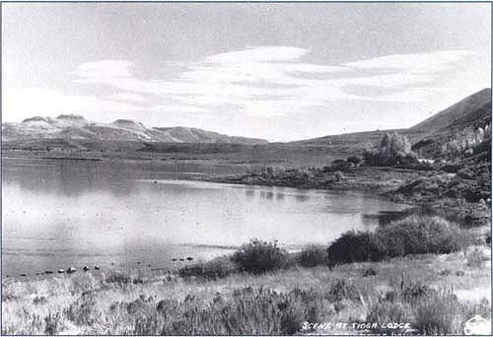
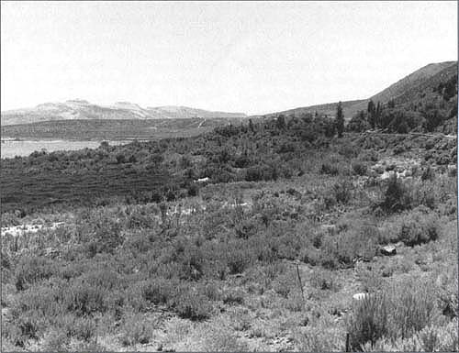
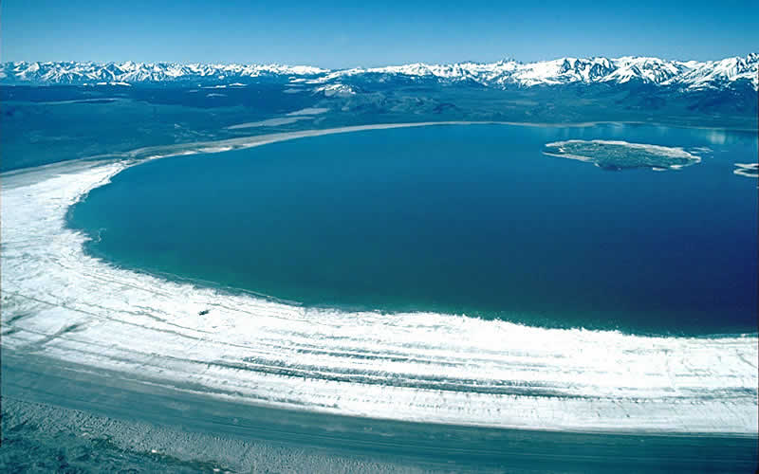
Mono Lake
In 1941, L.A. DWP started diverting Mono Basin streams to add to L.A. Aqueduct
Mono Lake’s volume halved while salinity doubled. The simple ecosystem began to fail and threatened migrating birds and nesting gulls.
The state and courts now mandate raising the level of the lake 17 feet. It will take about 20 years.

Slide 10
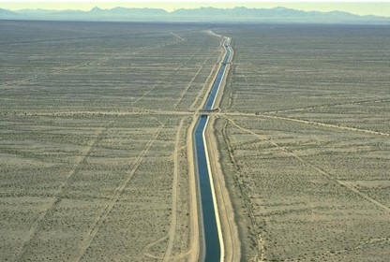
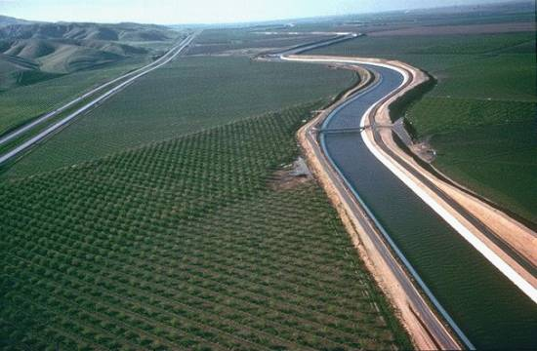
Colorado River Aqueduct
Established 1928 to bring water to L.A. and rest of Southern California
First delivery in 1940; serves 15 million people
Lawsuit from Arizona (1953) finally began to be implemented in 1985 - amount will decrease and this amount will be replaced by State Water Project water

Slide 11
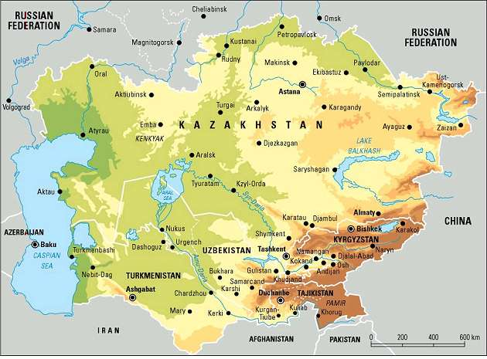
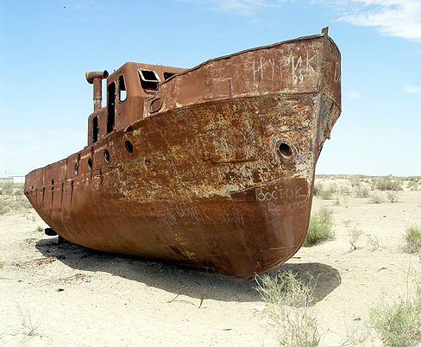
Aral Sea Disaster
Aral Sea was once the world’s 4th largest freshwater lake
Since 1960, enormous amounts of irrigation water have been diverted for irrigation of cotton and rice
This large-scale water diversion project, coupled with droughts and high evaporation rates in this area’s hot and dry climate, has caused a ecological, economic and health disaster.

Slide 12
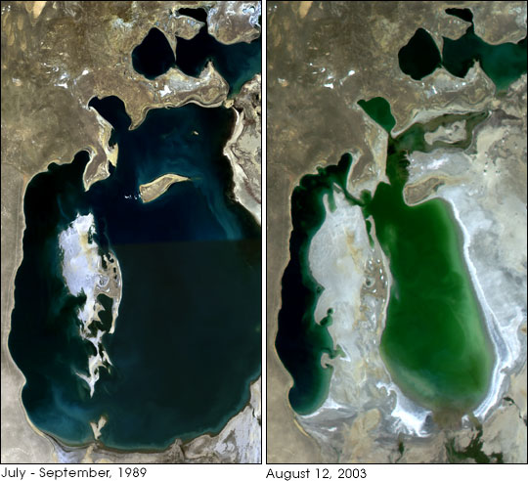
Aral Sea (video)
Led to 85% loss of wetlands→ loss of major birds and mammals in the area
Salt concentrations increase→ decrease in fish pops. and spreading of salt to croplands
Increase in salt, dust and toxic contaminants in Aral Sea watershed has led to health problems.
*In 1999, UN and World Bank stepped in and spent $600M to purify drinking water and upgrade irrigation and drainage systems.

