Slide 1
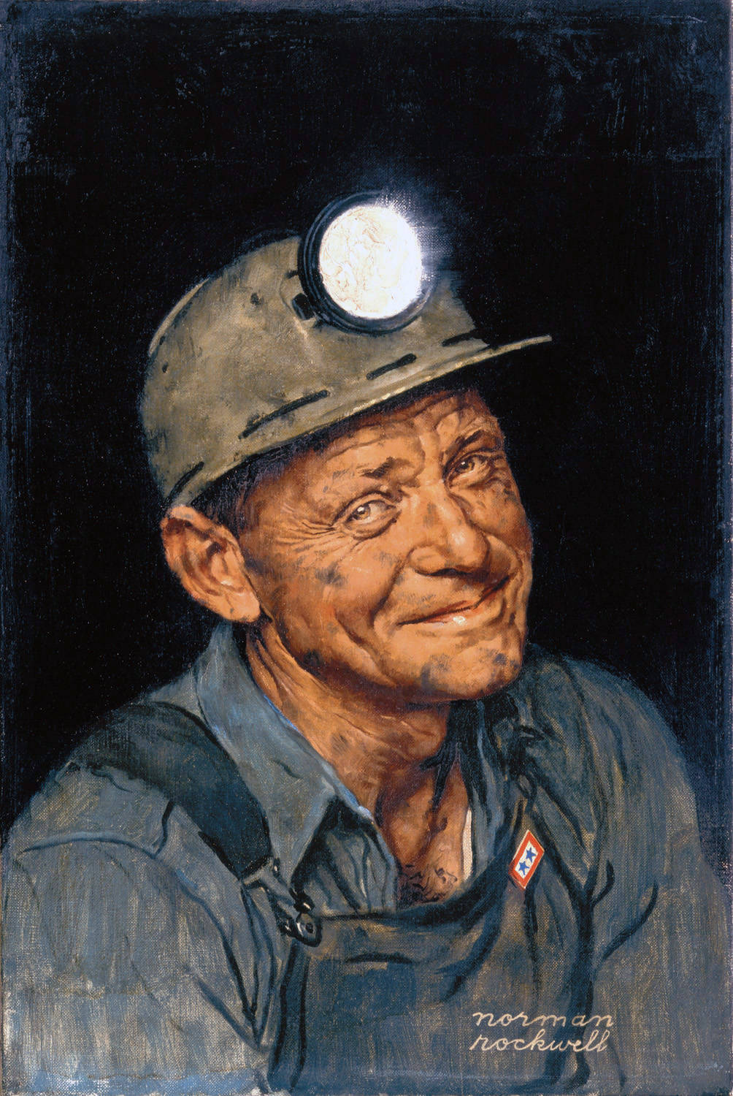
Mining

Slide 2
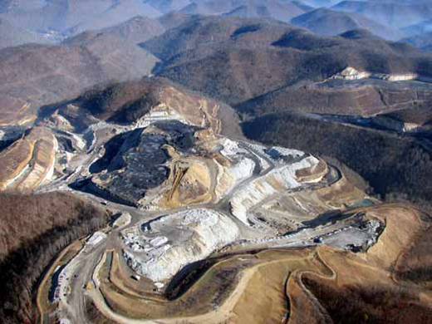
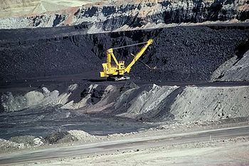
Surface Mining
Machines strip away overburden of soil & rock & usually discards it as waste material (spoil)
Used to retrieve shallow mineral deposits

Slide 3
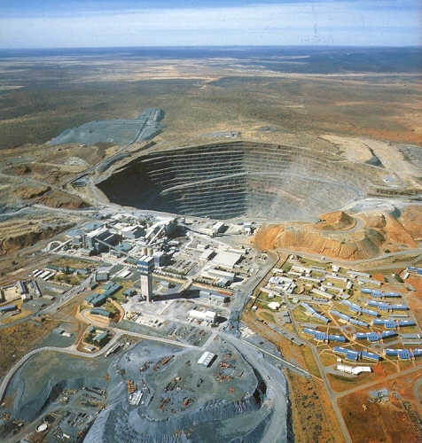
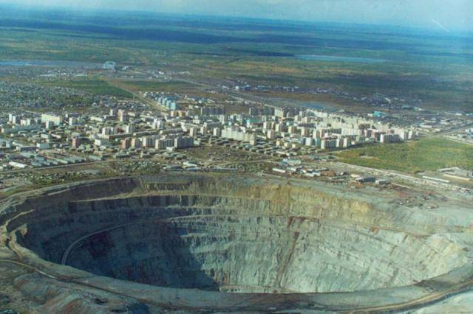
Surface Mining
Open-pit mining—machines dig holes and remove ores such as iron & copper and sand, gravel, & stone

Slide 4
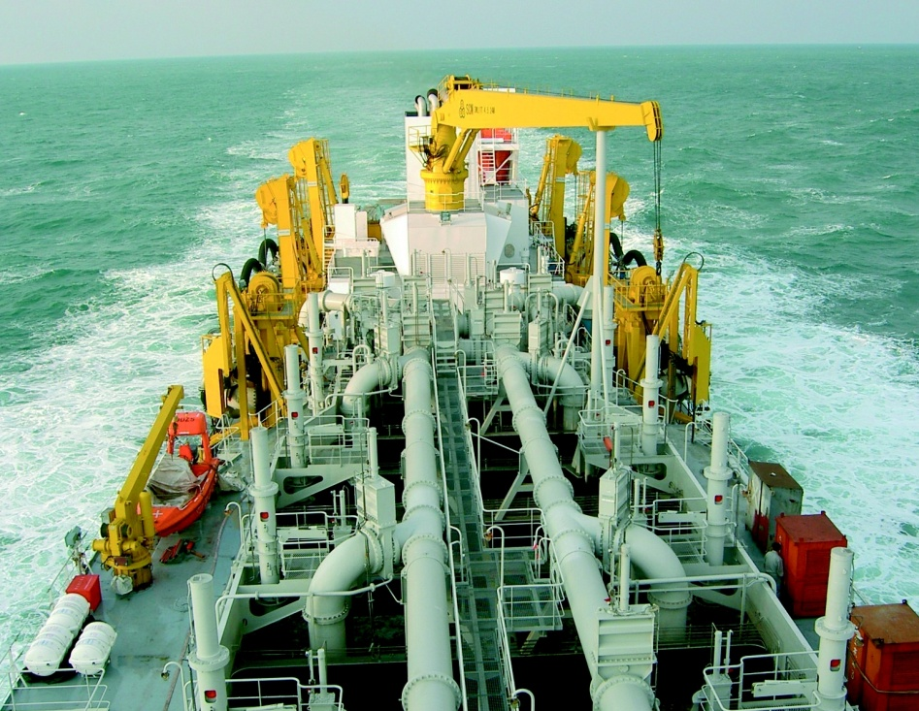
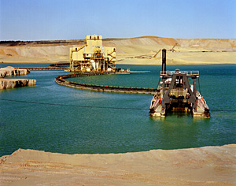
Surface Mining
Dredging—chain buckets & draglines scrape up underwater mineral deposits

Slide 5
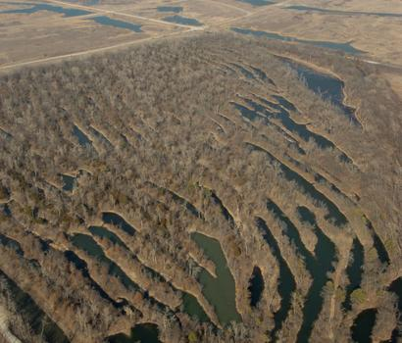
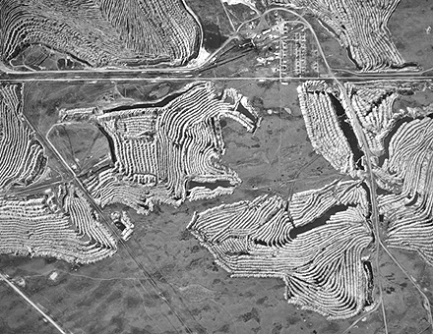
Surface Mining
Area strip mining (animation)
Overburden stripped away
Mineral deposit removed by power shovel
Trench filled with overburden
Repeated adjacent to initial cut
Used on fairly flat terrain

Slide 6
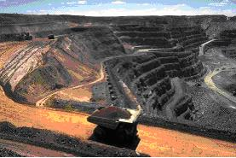
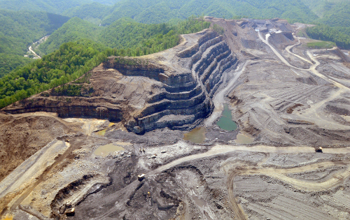
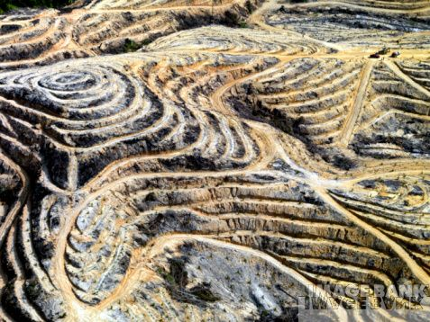
Surface Mining
Contour strip mining
Terraces cut into hillside
Overburden removed
Power shovel extracts coal
Overburden from new terrace is dumped into the one below
Used on hilly or mountainous terrain

Slide 7
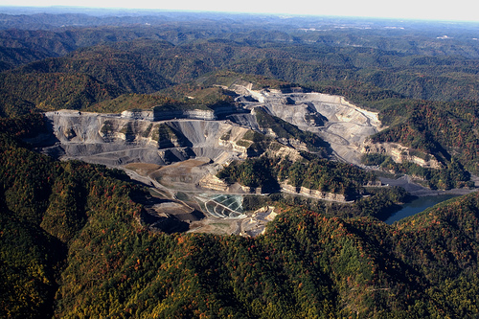
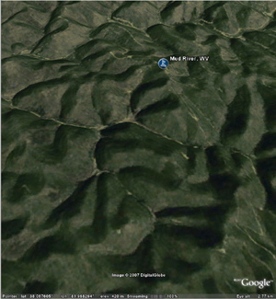
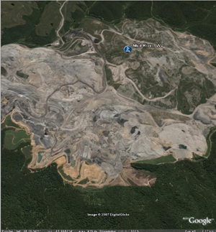
Surface Mining
Mountaintop Removal
Mountaintops are completely removed
Debris is dumped into the valleys
Video (5 min)

Slide 8
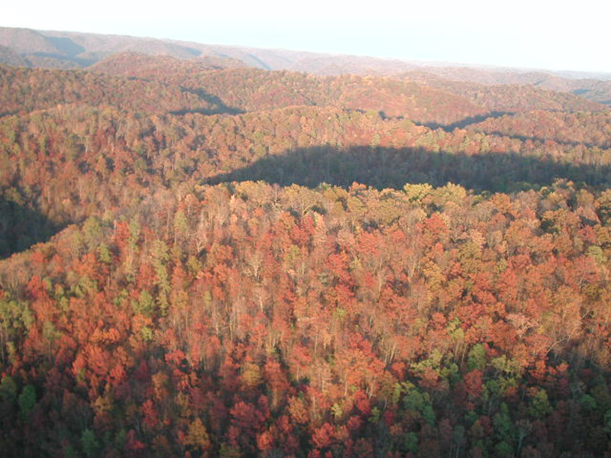
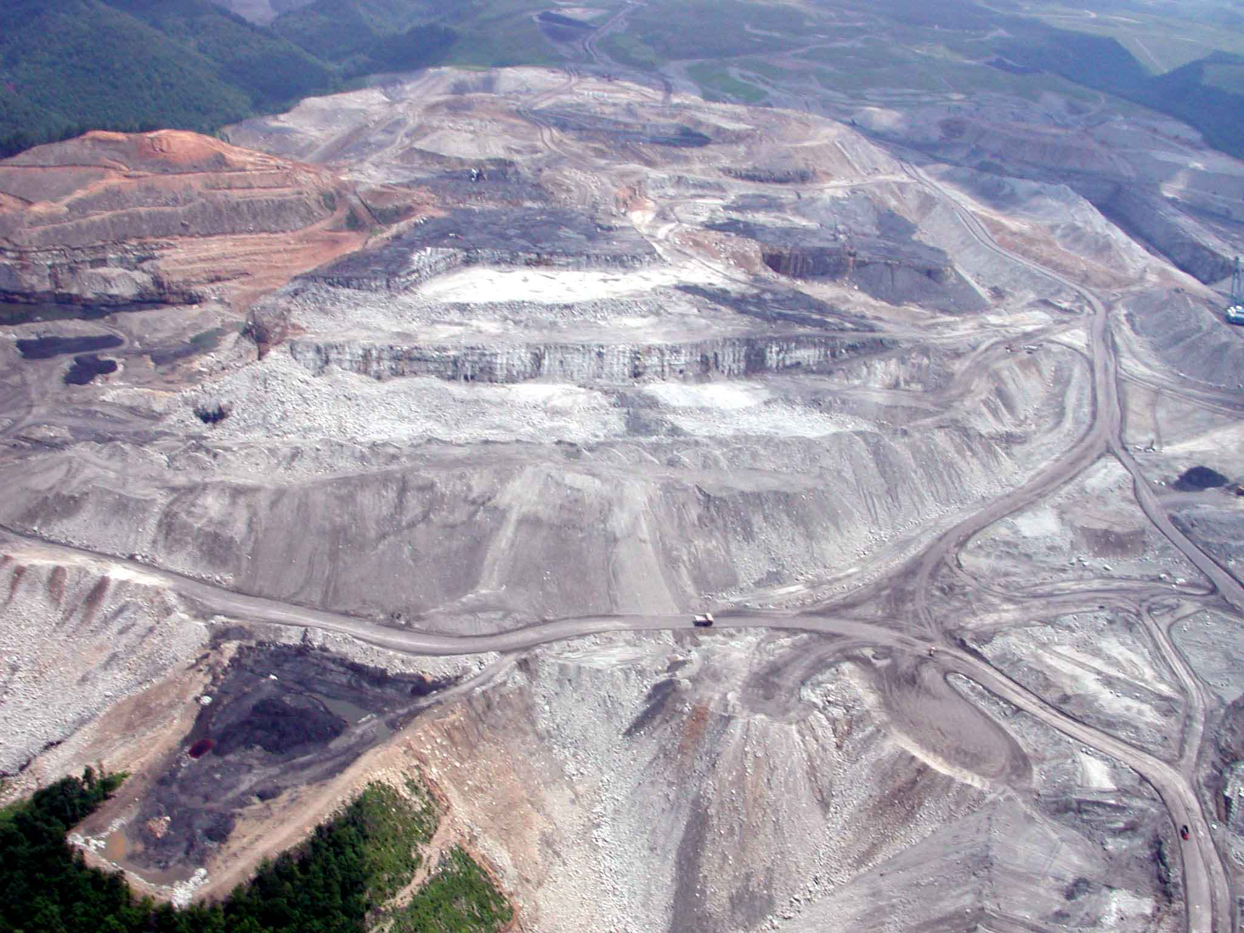
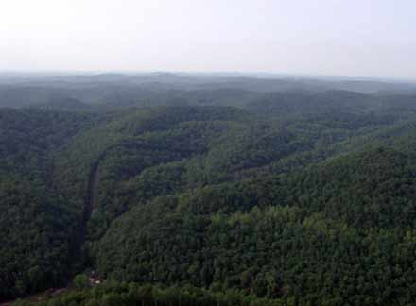
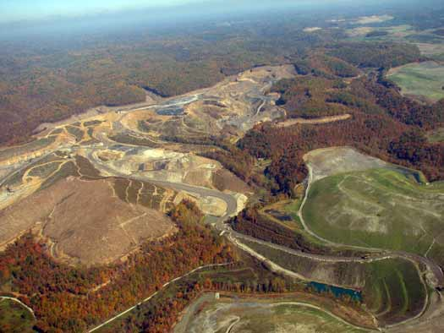

Slide 9
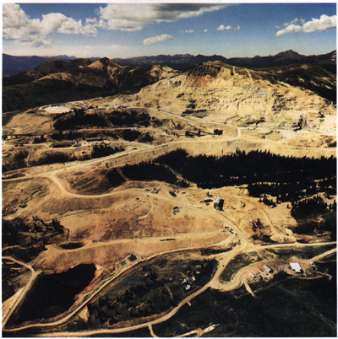
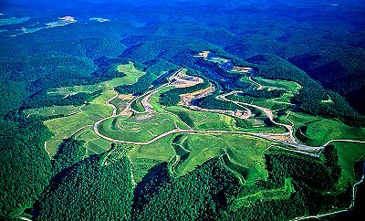
Surface Mining
Restoration
Difficult and usually incomplete
Most surface mining is in arid/semiarid regions
Damage to these biomes is almost always permanent

Slide 10
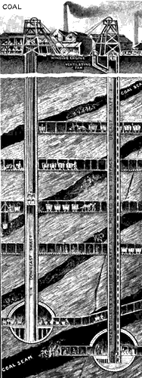
Subsurface Mining
Used to remove coal & metal ores that are too deep to be extracted by surface mining
Dig deep vertical shaft
blast subsurface tunnels & chamber to get to deposit
use machinery to remove minerals & transport to the surface

Slide 11
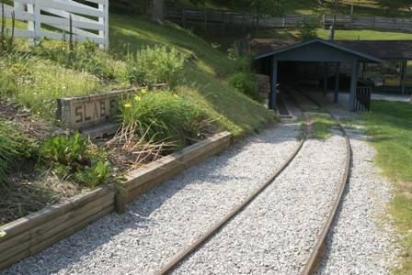
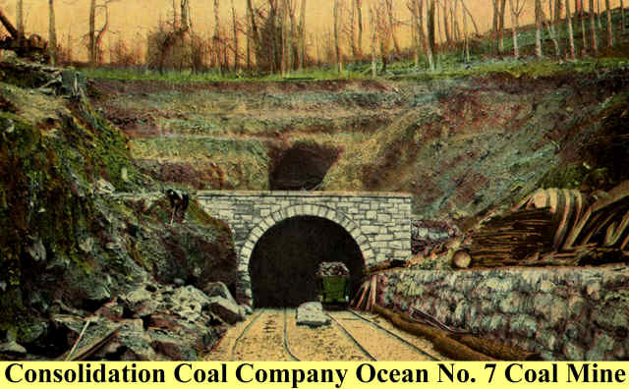
Subsurface Mining
Disturbs less than 1/10 as much land as surface mining & produces less waste material
Leaves much of the resource in the ground & is more dangerous and expensive

Slide 12
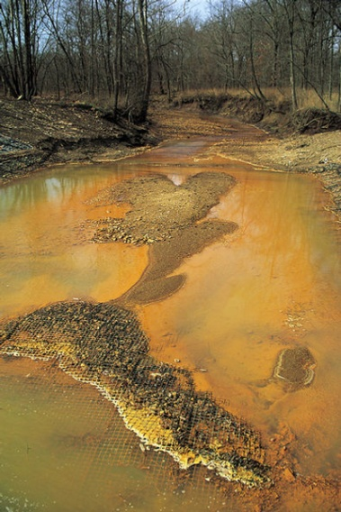
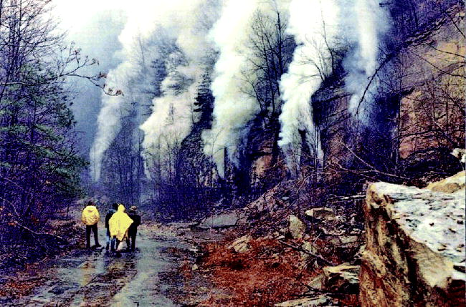
Environmental Effects of Mining
Land Surface:
scarring and disruption
fires in coal mines
land subsidence causing houses to tilt, cracked sewer lines, broken gas mains and disrupted groundwater systems
erosion of spoil heaps and tailings by water and wind
air and water pollution

Slide 13
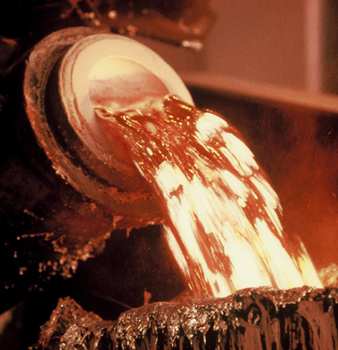
Environmental Effects of Mining
Rainwater seeping through a mine or mine waste can carry sulfuric acid to nearby streams
Smelting—used to separate metals from other elements in the ore mineral
Emit enormous quantities of air pollutants
SO², soot, tiny particles of arsenic, cadmium, lead and other heavy metals
Other mining wastes: radioactive uranium compounds, compounds of lead, mercury, arsenic and cadmium

Slide 14
Substitutes for Scarce Nonrenewable Mineral Resources
Some substitutes are possible – e.g., we are currently using ceramics and plastics as replacements for metals
Substitutes may be found, but the search is costly and it takes time to phase in new materials and processes.
Some substitutes are inferior
Finding some substitutes may be very difficult or impossible

